Slide 1
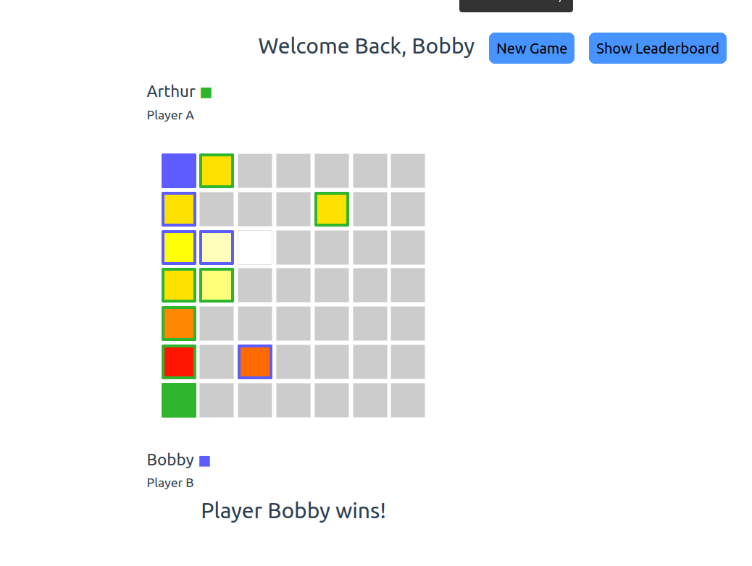
Heatsweep on Azure AWS
By Ryan J. Skelly
IT791 - 4/24

Slide 2

Purpose
Game
2 Player game
Objective:
Use color to uncover Hotspot
Connect a line from Starting Corner to HotSpot
Leaderboard + ELO
Random
Stand Up Heatsweep
Accessible & Resilient
Cloud Native w/o Refactor
Easy to Use

Slide 3
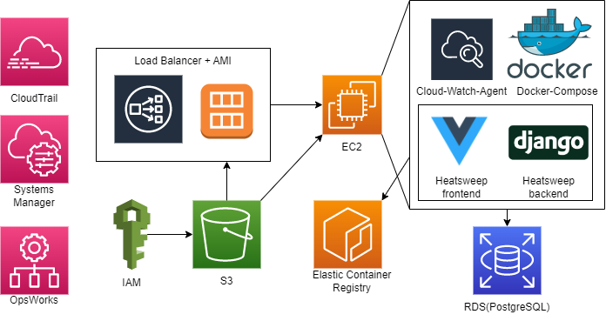
Component Diagram

Slide 4
Architectural pillars
Security
In and Outbound VPC Hardened with bare-minimum open ports(4)
Encrypted Communication between EC2 and RDS
Modifications to any service require root IAM privileges
Reliability
Load Balancer, and Auto Scaling Enabled, w/ Health Checks
Spawned from AMI templates
Elastic IP set on Load Balancer to make it reachable from the same IP every time
Performance
Auto Scale starts when average CPU usage is >70%
CloudTrail to track and log API usage
Cost Optimization
Cost Explorer and Trusted Advisor have been enabled to provide sufficient cost insights and suggestions
Spot Availability on all EC2 instances, and RDS
Operational Excellence
CloudWatch logging instantiated on all EC2 instances
AWS Systems Manager used to track aggregate anomalies
OpsWorks to map anomalies to bug/issue creation

Slide 5
Azure -> AWS
Azure Weaknesses
Container Loading
Web App Configuration
AWS Weaknesses
EC2 Availability
EKS vs Azure K8s
Shared Weakness
Domain Names + LetsEncrypt
Docker-Compose
AWS Strengths
Dynamic Spot Instances
Kubernetes Alternative(EC2 Auto Scaling)
Cost Insights
Other Success
Free Tier
Container Registries
Dynamic Lift-and-Shift Model
Log reachability
SMS Alerts
Mobile App

Slide 6

Future Work
Github Workflows
Unit and Integration Testing
Django -> Lambda
IAM Role Implementation
Domain Registrar
Google Domains for HTTPS
App Development

Slide 7
Demo
52.204.9.238

